Slide 1
ZOMATO ANALYSIS

Slide 2
Introduction:
Zomato is an Indian multinational restaurant aggregator and food delivery company founded by Pankaj Chaddah and Deepinder Goyal in 2008. Zomato provides information, menus and user-reviews of restaurants as well as food delivery options from partner restaurants in select cities.
Services
Zomato is a restaurant aggregator and food delivery company that offers a variety of services, including:
Restaurant discovery and search
Online food ordering
Table reservations
Menu and review information
Photo sharing and viewing
Event organizing
Payment aggregator and gateway services

Slide 3
Objective:
The main objective is to query the given data and produce meaning full insight to understand better about the Work culture and other aspects that influence the job.
ML algorithms is used to explore, analyze, and find meaning in complex data sets. They can perform tasks such as pattern recognition, classification, and prediction. We also used Feature engineering to improve the performance of machine learning algorithms by transforming raw data into relevant inputs
MYSQL is used to analyze the data. Used Constraints, Aggregate functions, DQL (Data Query Language),DML (Data Manipulation Language), string functions, joins.
Power Bi Dashboard to display the visualization of the dataset to summarize the data.

Slide 4

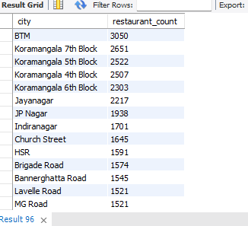
SQL QUERY
Get some important insight from data.
Total no of record present in dataset.
select count(*) from zomato;
No. of restaurant present in distinct city.
SELECT city, COUNT(*) AS restaurant_count FROM zomato GROUP BY city ORDER BY restaurant_count DESC limit 15;

Slide 5
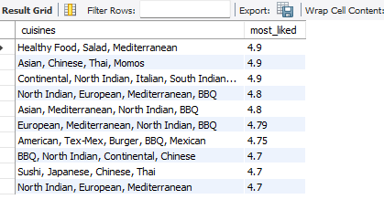
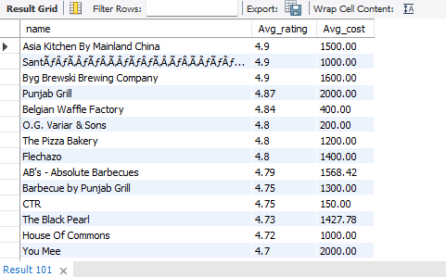
Select cuisines from data which should have rating > 3.5
with abc as(select cuisines,round(avg(rate),2) as most_liked from zomato group by cuisines)select * from abc where most_liked >=3.5 order by most_liked desc limit 15;
Select restaurant name which have avg cost ,having rating >4 with help of CTE.
with xyz as(select name,round(avg(rate),2) as Avg_rating,round(avg(cost),2) as Avg_cost from zomatogroup by name)select * from xyz where Avg_rating>4order by Avg_rating desc limit 15;

Slide 6
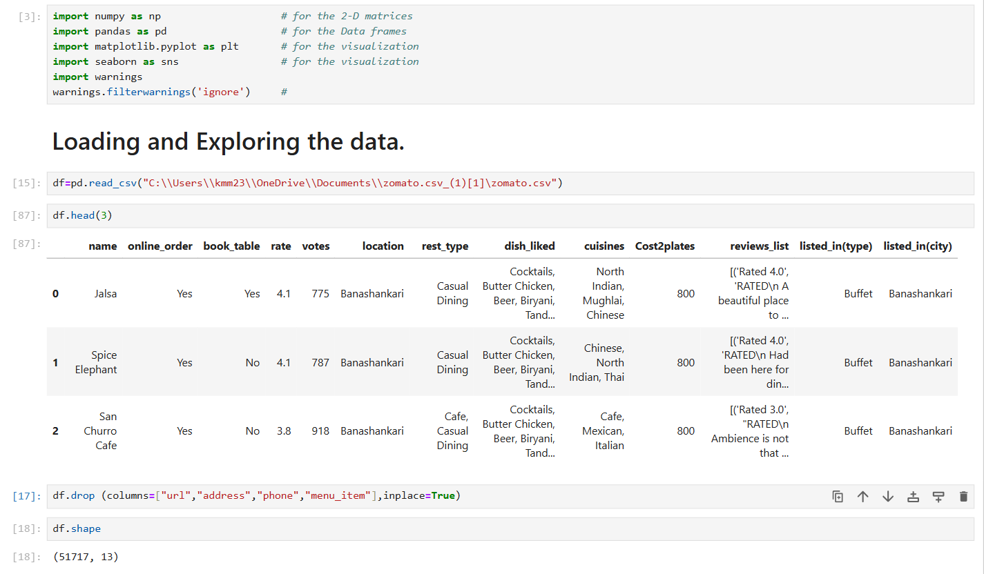
MACHINE LEARNING
Import important libraries and dataset:

Slide 7
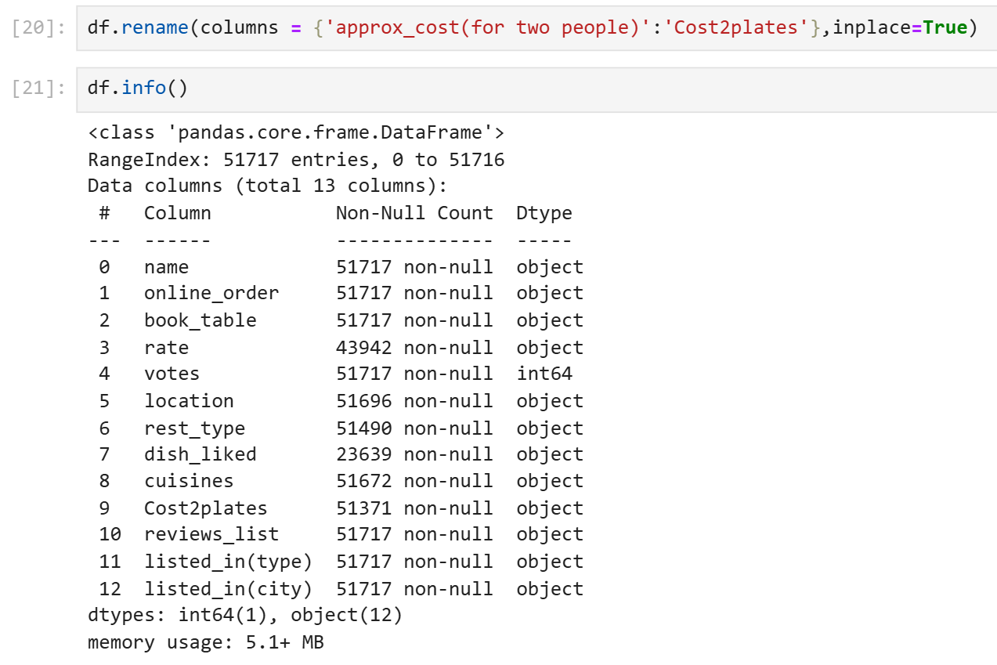
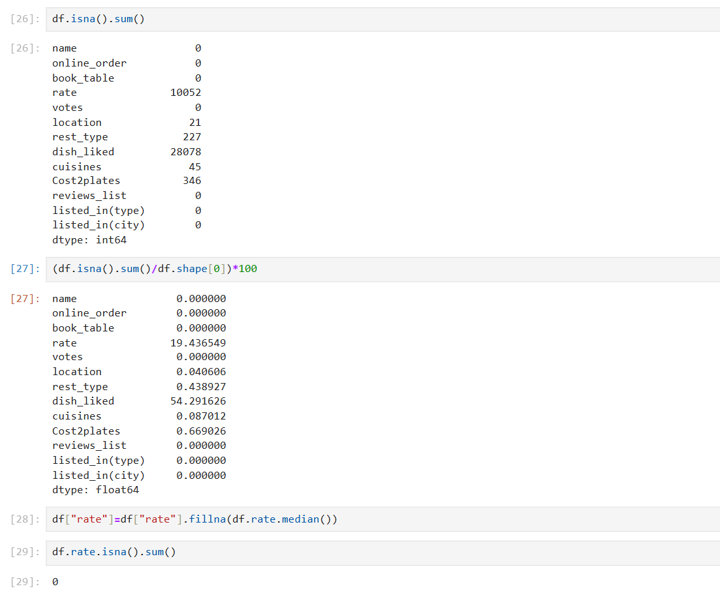
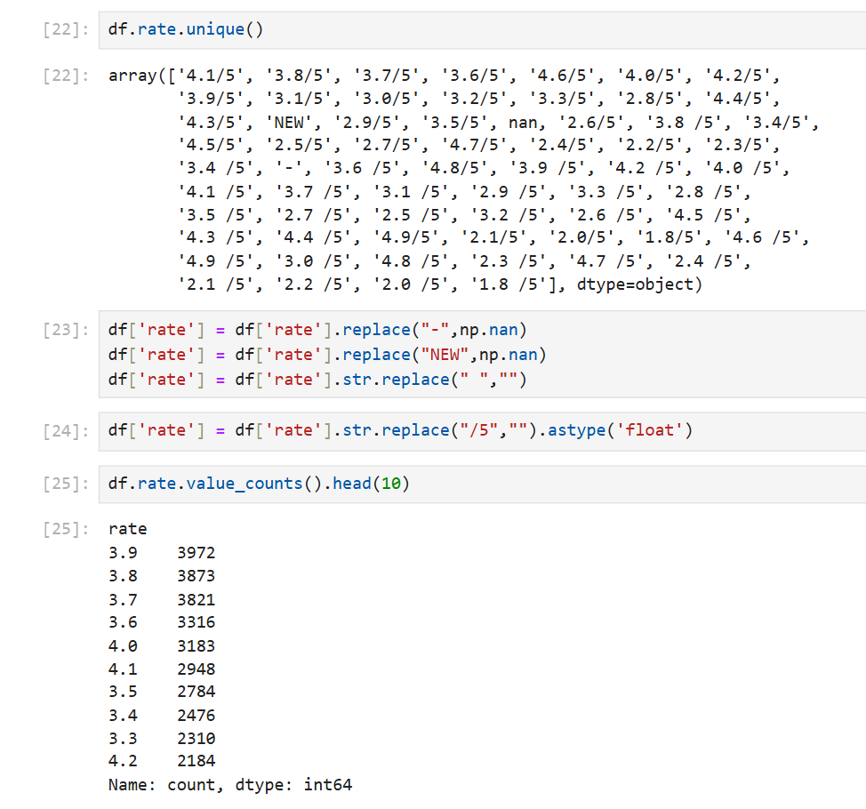
Summary:
Check info of dataset.
2. Checking null values and filling it.
3. Cleaning some columns and change datatype.

Slide 8
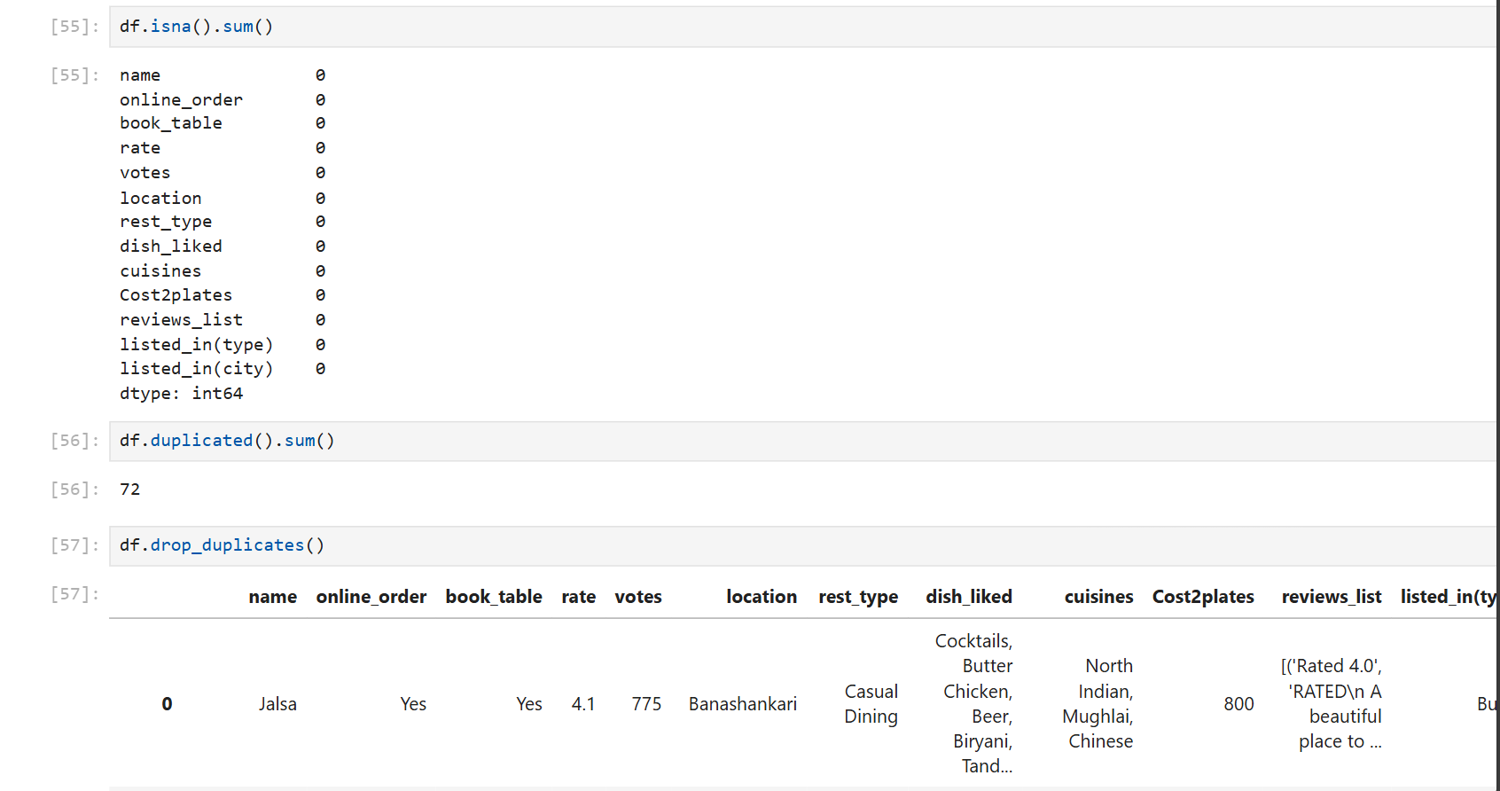
Fill null values and drop duplicates

Slide 9
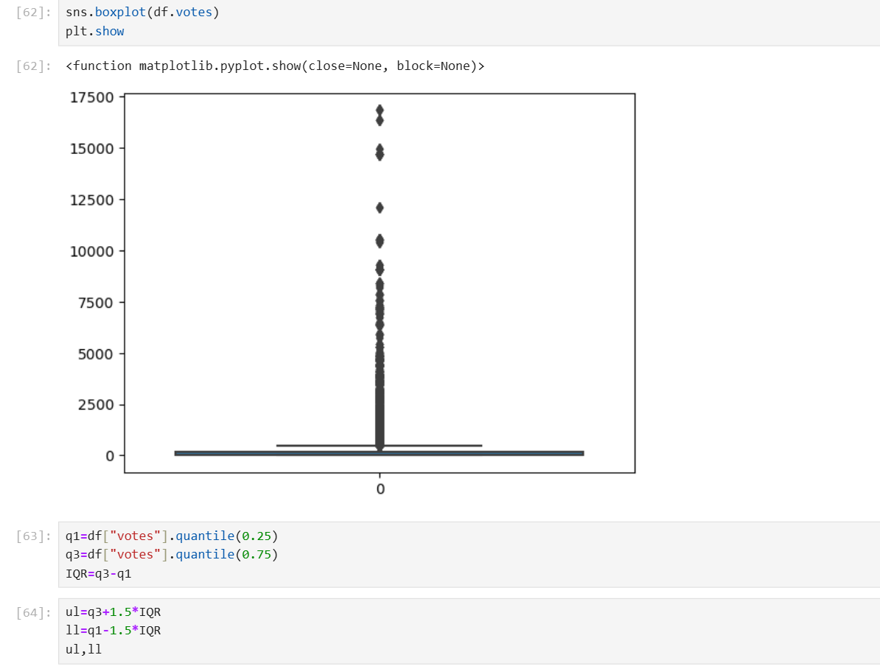
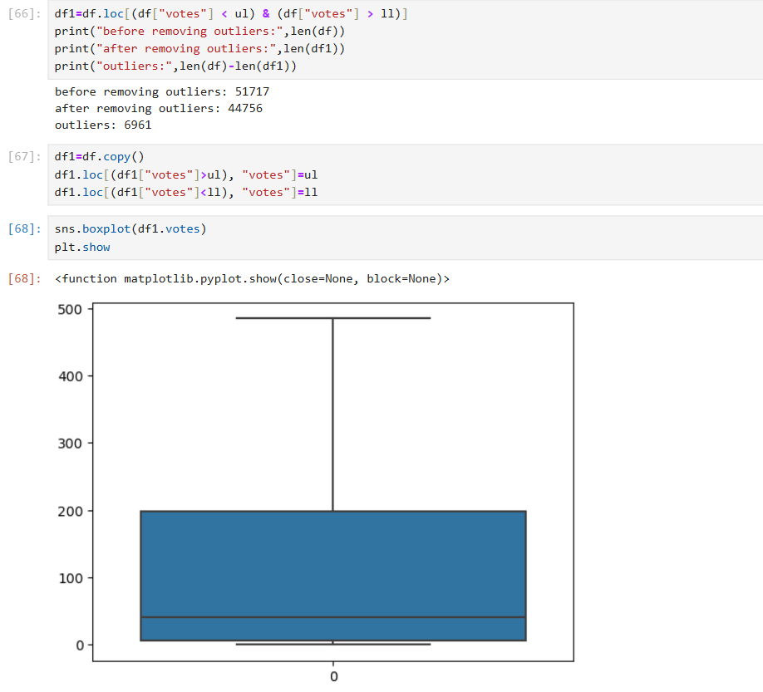
Detecting and treating outliers:
outliers
After treating

Slide 10
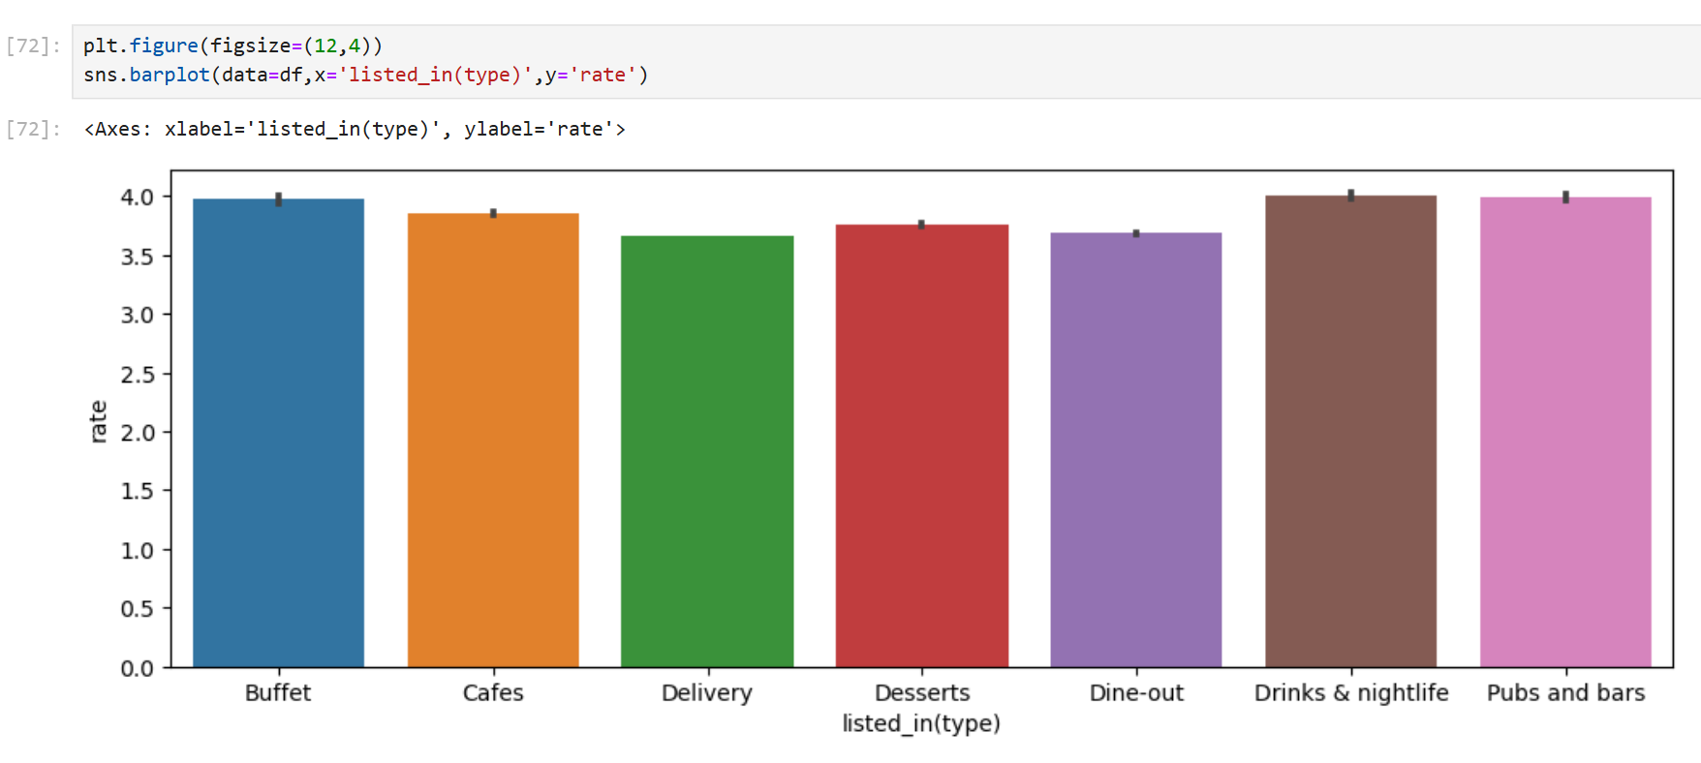
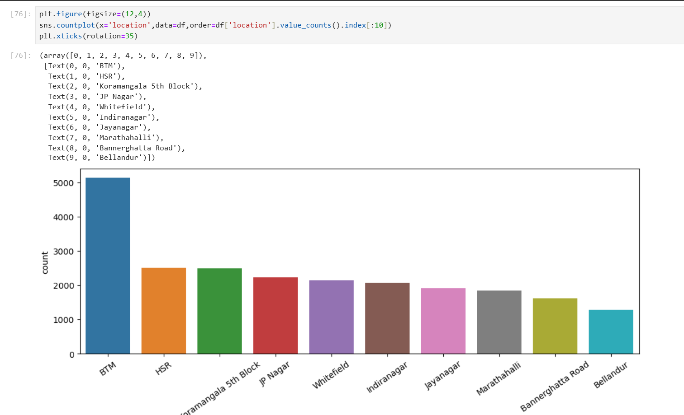
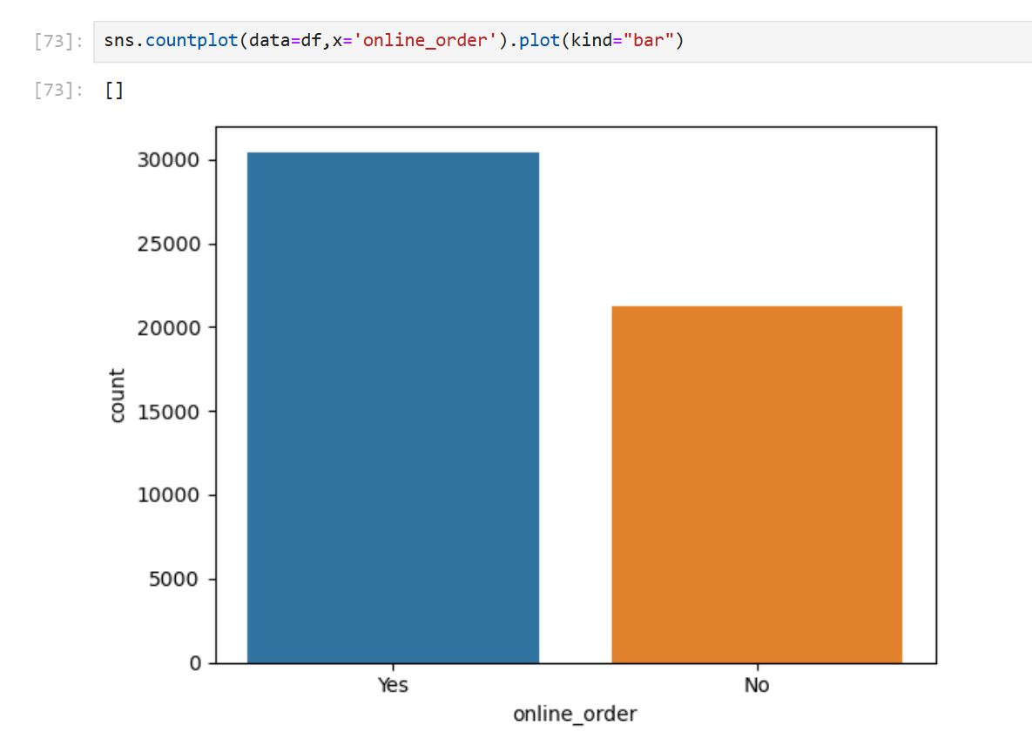
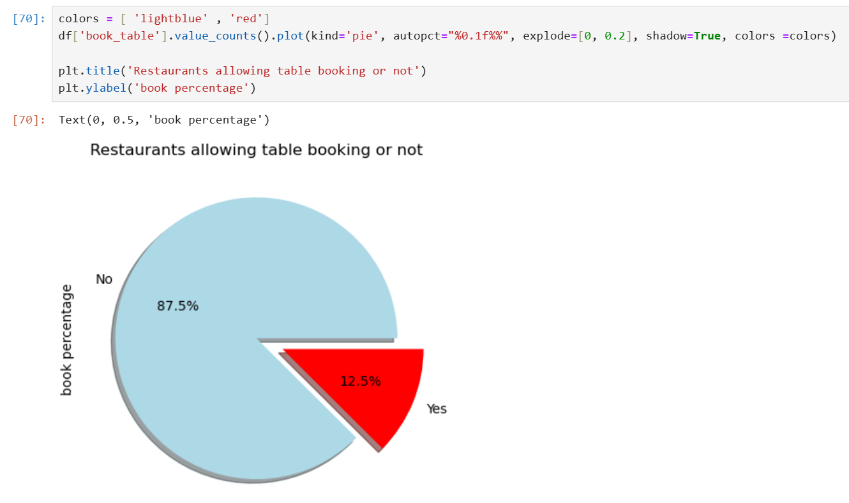
Data visualization

Slide 11
Create ML Model on different-different algorithm
Import all algorithm from sklearn libraries:
from sklearn.linear_model import LinearRegression
from sklearn.metrics import mean_squared_error,r2_score
from sklearn.tree import DecisionTreeRegressor
from sklearn.metrics import mean_squared_error,r2_score
from sklearn.model_selection import GridSearchCV
from sklearn import metrics
from sklearn.ensemble import RandomForestRegressor
from XGboost import XGBRFRegressor
from sklearn.model_selection import train_test_split

Slide 12
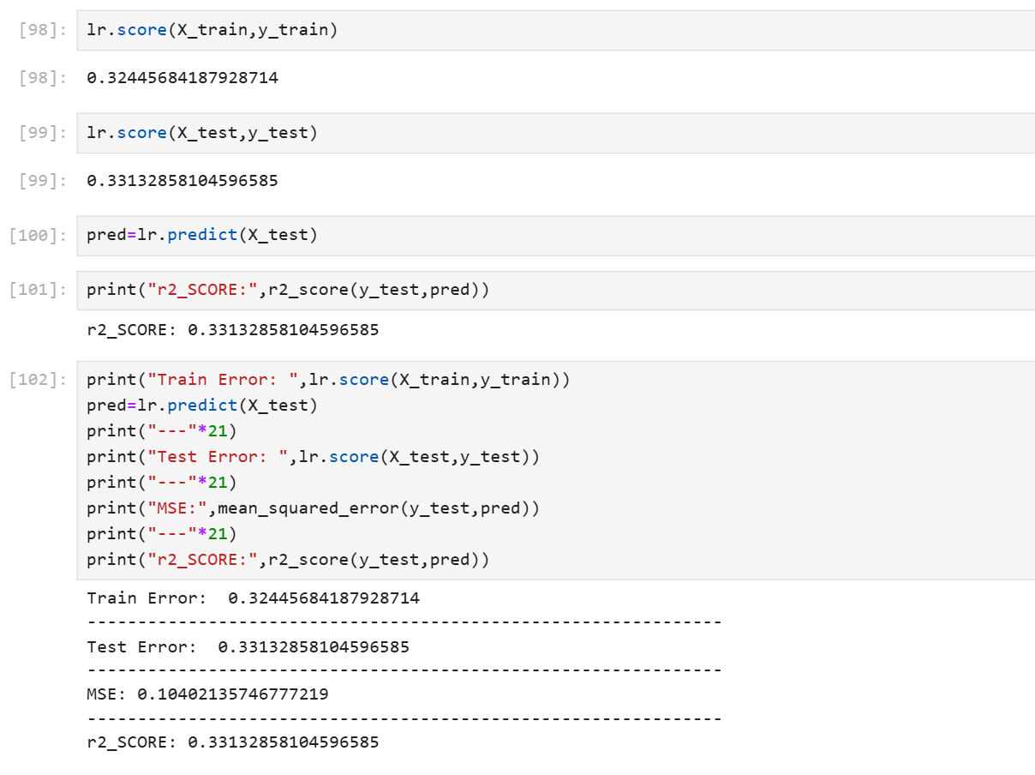
Create ML Model on different-different algorithm
1. Linear Regression:
Logistic regression is one of the most popular Machine Learning algorithms, which comes under the Supervised Learning technique. It is used for predicting the categorical dependent variable using a given set of independent variables.
It predicts the output of a categorical dependent variable. Therefore the outcome must be a categorical or discrete value

Slide 13
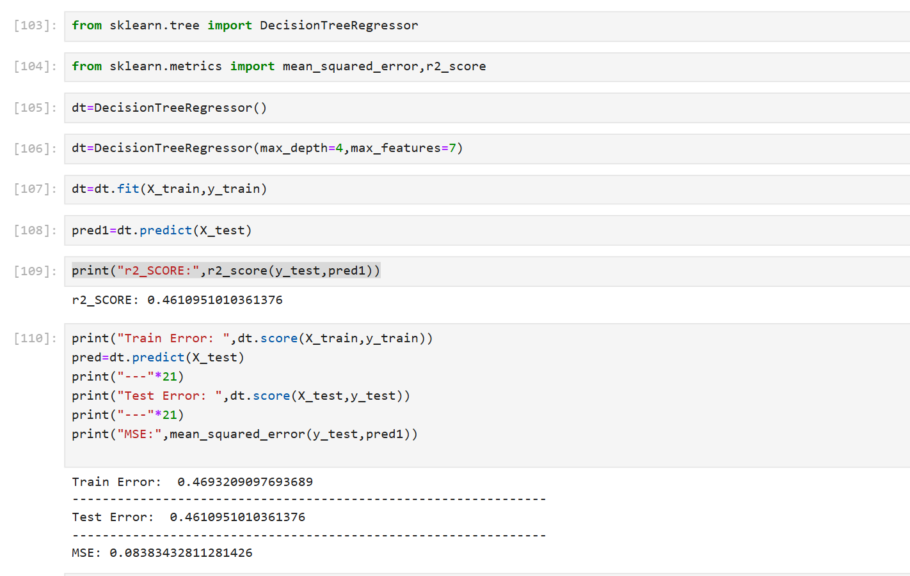
2. Decision Tree Regressor:
Decision Tree is a Supervised learning technique that can be used for both classification and Regression problems, but mostly it is preferred for solving Classification problems. It is a tree-structured classifier, where internal nodes represent the features of a dataset, branches represent the decision rules and each leaf node represents the outcome.
It is a graphical representation for getting all the possible solutions to a problem/decision based on given conditions.
In order to build a tree, we use the CART algorithm, which stands for Classification and Regression Tree algorithm.
A decision tree simply asks a question, and based on the answer (Yes/No), it further split the tree into subtrees.

Slide 14
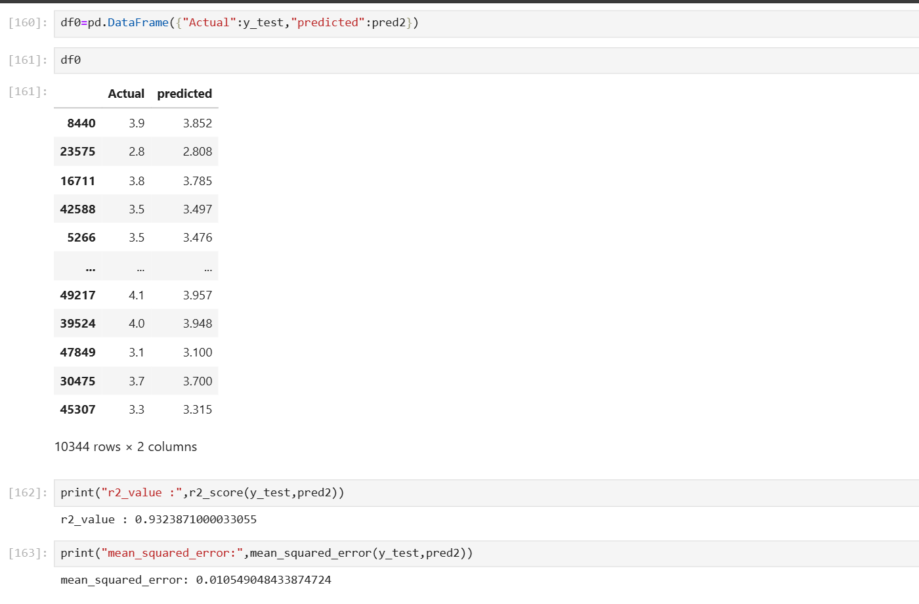
3. Random Forest Regressor
Random Forest is a classifier that contains a number of decision trees on various subsets of the given dataset and takes the average to improve the predictive accuracy of that dataset."
The greater number of trees in the forest leads to higher accuracy and prevents the problem of overfitting.
It can be used for both Classification and Regression problems in ML. It is based on the concept of ensemble learning, which is a process of combining multiple classifiers to solve a complex problem and to improve the performance of the model.

Slide 15
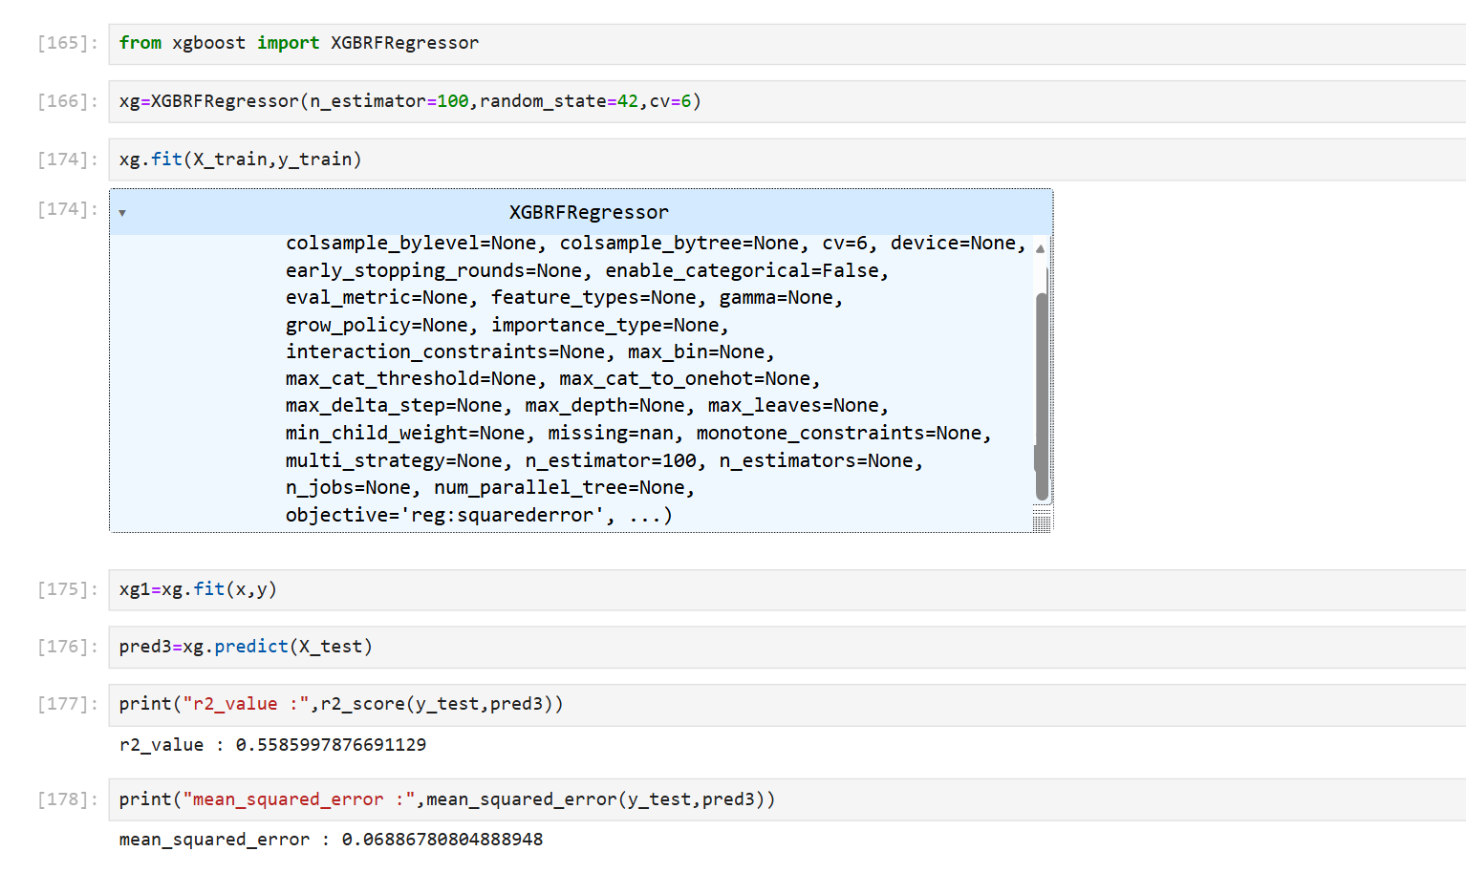
4. XGB Random Forest Regressor
XGBoost and Random Forest are both machine learning algorithms that can be used for regression and classification:
XGBoost
An open-source library that uses a gradient boosting ensemble algorithm to train models efficiently. XGBoost is known for its ability to handle large datasets, address missing values, and perform well in regression and classification tasks. XGBoost is more complicated than Random Forest, but it's considered to be more accurate and better performing.

Slide 16
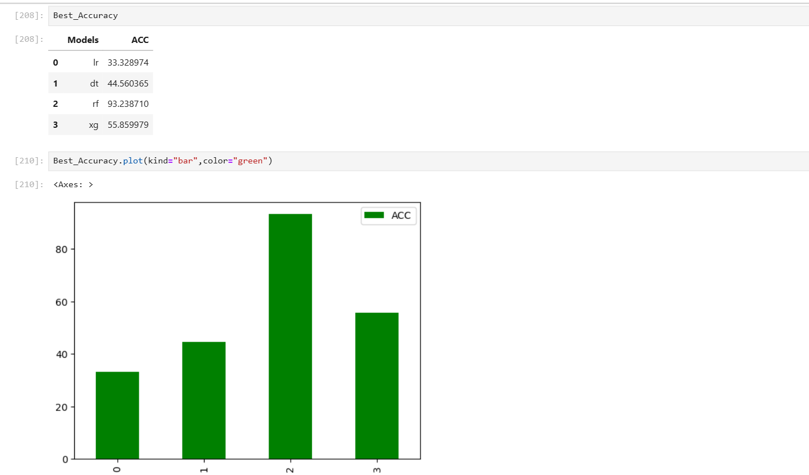
Comparision the accuracy of all the model

Slide 17
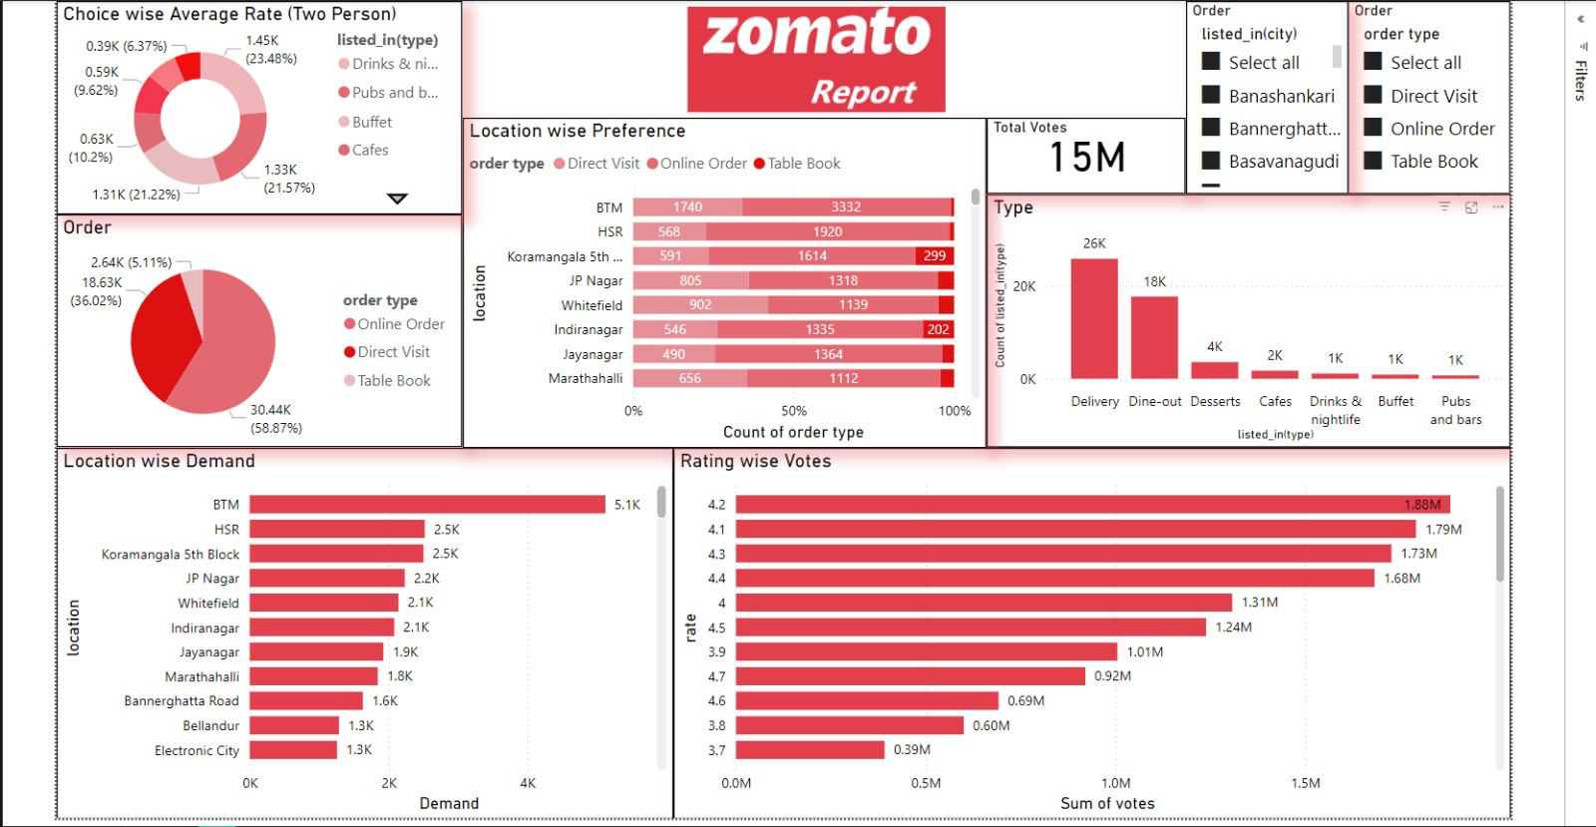
ZOMATO POWER BI DASHBOARD

Slide 18
Conclusion:
North Indian is the most popular cuisine among the customers followed by Chinese , Fast food , Mughlai and Bakery.
Zomato's success can be attributed to its innovative business model, its focus on customer experience, and its ability to adapt to changing market conditions. As the food delivery industry continues to grow and evolve, Zomato is well-positioned to continue its success and expand its reach into new markets.

Slide 19
Suggestions
The Average cost of two and price range can be used to segmentize the budget range such as low , mid and high thus allowed targeted market strategies for the particular range.
Most restaurants do not offer online delivery and table booking following the traditional dining culture , This creates an opportunity for introducing these services as these services increase the customer reach.
Zomato should expand into more countries to capture more market and to have high customer reach .

Slide 20
THANK YOU

